Slide 1
Whip Your Scripts into Shape: Optimizing PowerShell for Speed
Joshua King

Slide 2
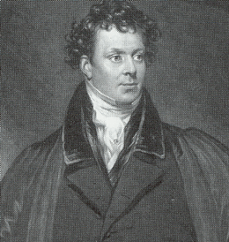
Who Am I?
Josh King
https://king.geek.nz
@WindosNZ

Slide 3
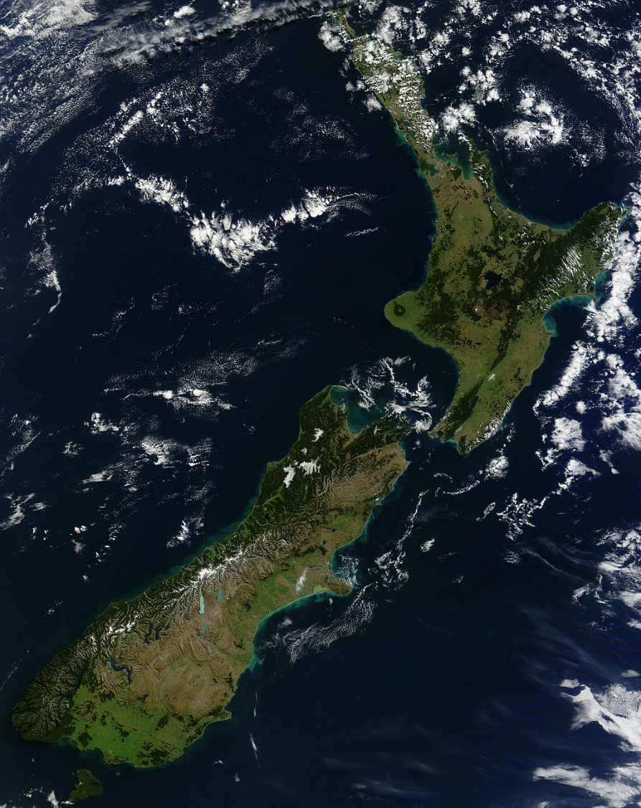




Credit: Tim Whittaker

Slide 4
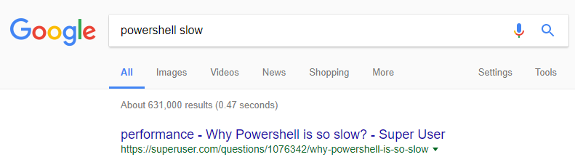
Speed & PowerShell
(Still a better love story than Twilight)
Bad perception, possibly thanks to start up times
Common complaint

Slide 5
A/B Testing
If you’re looking for improvements, measure it!
One change at a time
Test it more than once
Minimize the impact introduced by taking measurements
My tests will be handled by the “RunBucket” module:
Start-RunBucket -Control $Control -Variation $Variation -Title 'A/B Test'

Slide 7
Are These Examples a Silver Bullet?
Memory consumption
CPU bottleneck
Breaking a working script
Your environment is a snowflake

Slide 8
Takeaways
Don’t assume
Measure twice
Revisit
Worry about optimisation after it’s working!
Try-out PowerShell Universal Dashboard (https://poshud.com)

Slide 9
Get this slide deck and demo code from:
http://bit.ly/WindosPSH2018

